Slide 1
SAP HANA 2.0 Security

Slide 2
What is SAP HANA Security
SAP HANA Security is protecting important data from unauthorized access and ensures that the standards and compliance meet as security standard adopted by the company.
Security Perspective in Different Implementation Scenarios
The way in which you implement SAP HANA determines what you need to consider from a security perspective.
The following main SAP HANA scenarios are possible:
SAP HANA as a data mart for reporting and analytics
SAP HANA in a classic 3-tier architecture as the primary database, for example, in SAP NetWeaver Business Warehouse (SAP NetWeaver BW) or SAP Business Suite installations
SAP HANA as a platform for providing database and application services to native SAP HANA-based applications
SAP HANA Provide following security-related feature
Authorization
Authentication
User and Role Management
Encryption of data in Network Layer
Encryption of data in Persistence Layer
Auditing

Slide 3
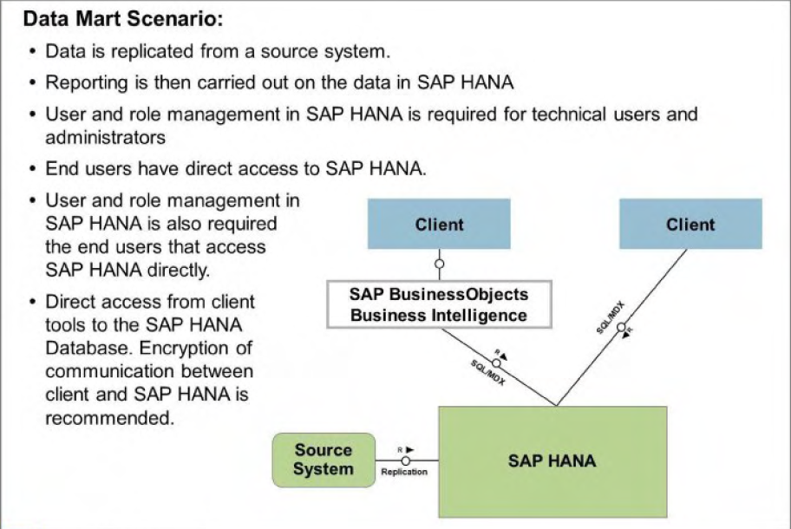
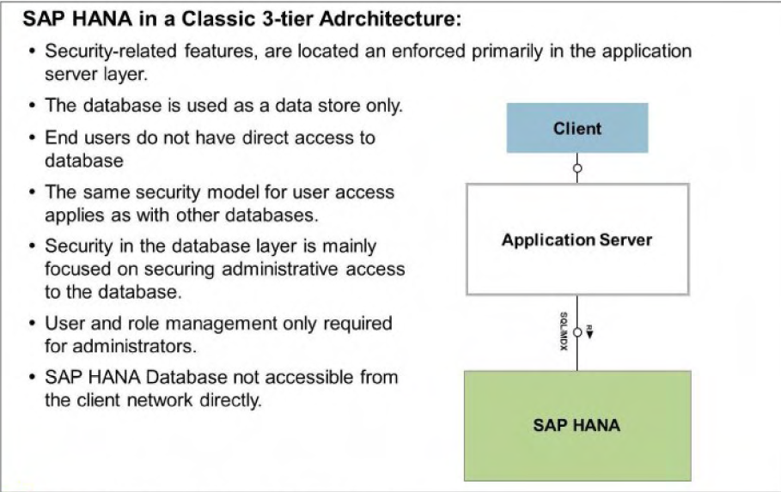
Scenarios

Slide 4
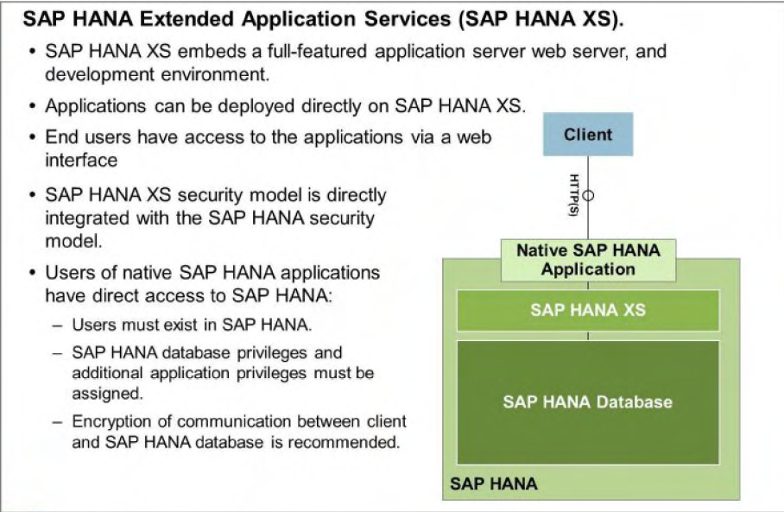
SAP HANA as a Platform

Slide 5
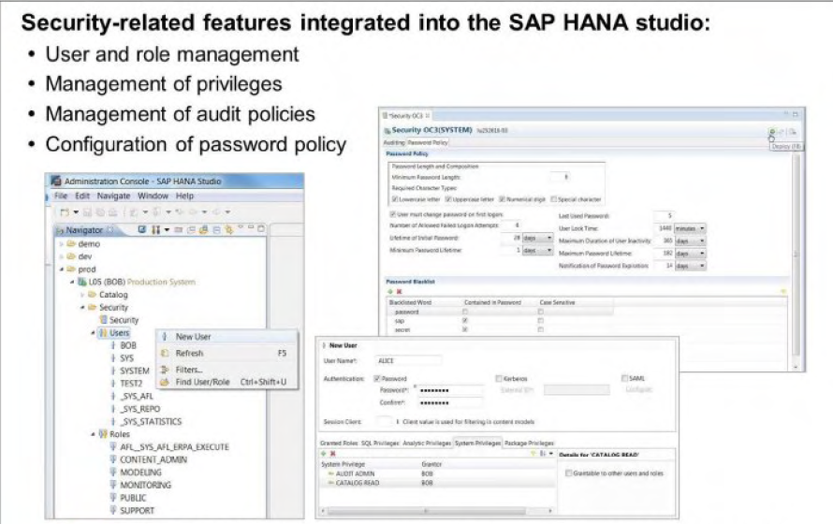
Many security-related features are integrated into the SAP HANA studio

Slide 6
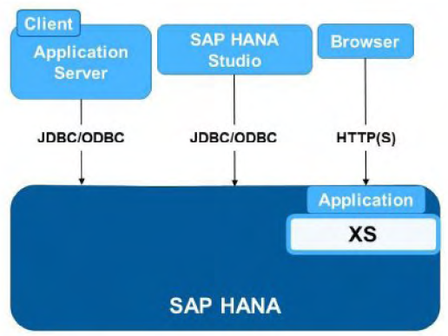
User Access Channels
Users are able to connect to SAP HANA via JDBC/ODBC or via HTTP /S. The protocol used for database client access (SQLDBC (ODBC/ JDBC)) is used in the following scenarios:
• Application servers that use SAP HANA as a database
• End-user clients that access the SAP HANA database directly
• SAP HANA studio
HTTP /S Client Access is used for a connection between a Web browser or a mobile device to applications based on SAP HANA Extended Application Services (SAP HANA XS).

Slide 7
Users
Database users are created as either standard user or as restricted user.
Standard users can create objects in their own schema and read data in system views. Read access to system views is granted by the PUBLIC role. which is granted to every standard user.
Restricted users. initially, have no privileges. Restricted users are intended for provisioning users who access SAP HANA through client applications and who are not intended to have full SQL access via an SQL console. If the privileges required to use the application are encapsulated within an application-specific role. then it is necessary to grant the user only
this role. In this way. it can be ensured that users have only those privileges that are essential to their work.
Compared to standard database users. restricted users are initially limited in the following ways:
• They cannot create objects in the database as they are not authorized to create objects in their own database schema.
• They cannot view any data in the database as they are not granted (and cannot be granted) the standard PUBLIC role.
• They are only able to connect to the database using HTIP.
JDBC/ODBC access is as follows:
• Enabled for normal users
• Disabled for restricted users
To disable or enable JDBC/ODBC access, use either SAP HANA Studio (user editor). or SQL commands.

Slide 8
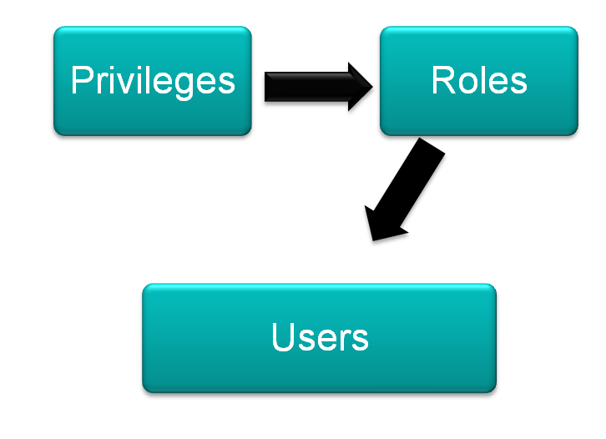

Authorization Concept in HANA
All users who want to access the SAP HANA database must be explicitly created in the database beforehand. A user who is connected using the external authentication provider but is not known to the database cannot access the database.
A known user can log on to the database. A user can be the owner of database objects.
A privilege is used to impose restrictions on operations carried out on certain objects.
A role is a collection of privileges and can be granted to either a user or another role (nesting).
Notes:
Privileges can be assigned to users directly or indirectly using roles. Privileges are required to model access control. Roles can be used to structure the access control scheme and model reusable business roles. Whenever a user tries to access an object, the system performs an authorization check using the user, the user's roles, and directly allocated privileges.

Slide 9
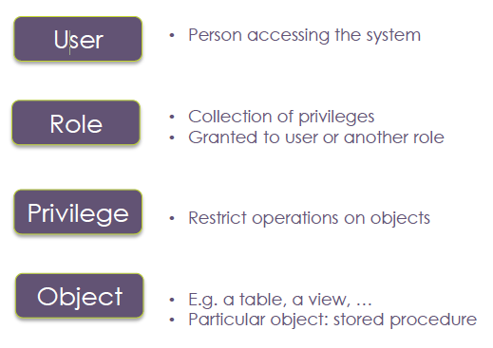
Authorization Entities
Goal
• Create user
• Manage users
• Assign security

Slide 10
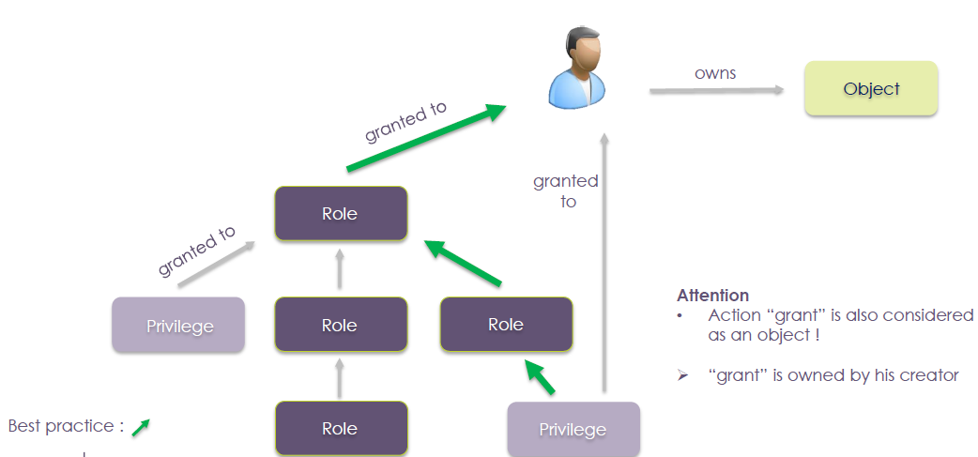
Entities Relation

Slide 11
User Types in HANA
There are three different types of users in a HANA Database. The following are conceptual separation and there is no technical difference as how the HANA database authenticates these users.
Users: Named normal users which represent real persons and are used for daily working with the SAP HANA database. These users are created and also assigned privileges/roles by the user administrator as per requirement.
System User: This user is the built-in overall system administrator and is created during the installation. It is recommended to use this user to create dedicated system administrator user and to assign powerful privileges to the user and not to be used for day to day activities.
3. Technical users: Eg: SYS, _SYS_STATISTICS, and _SYS_REPO .These are internal users within the SAP HANA database. The _SYS_STATISTICS user is used by the statistics server, and the _SYS_REPO by the repository. These users cannot log on from outside.
a. Application-specific technical users: For example, an application server may log on to the SAP HANA database using a dedicated technical user.

Slide 12
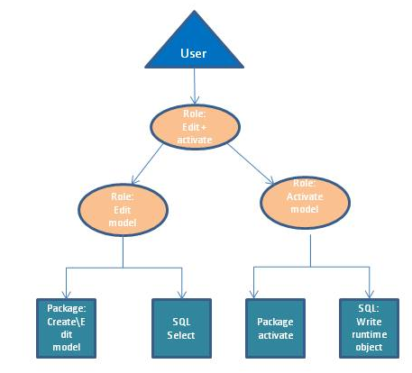




Roles in HANA
Roles allow grouping of privileges:
Roles are created for specific purposes, e.g.:
Create data models (on a given subset of data)
Activate data models
Manage users
Export\Import
Roles can be created using privileges or other roles (nested)
Roles/privileges can be assigned to users.
User/Role management are closely related
Some standard roles are delivered with HANA

Slide 13
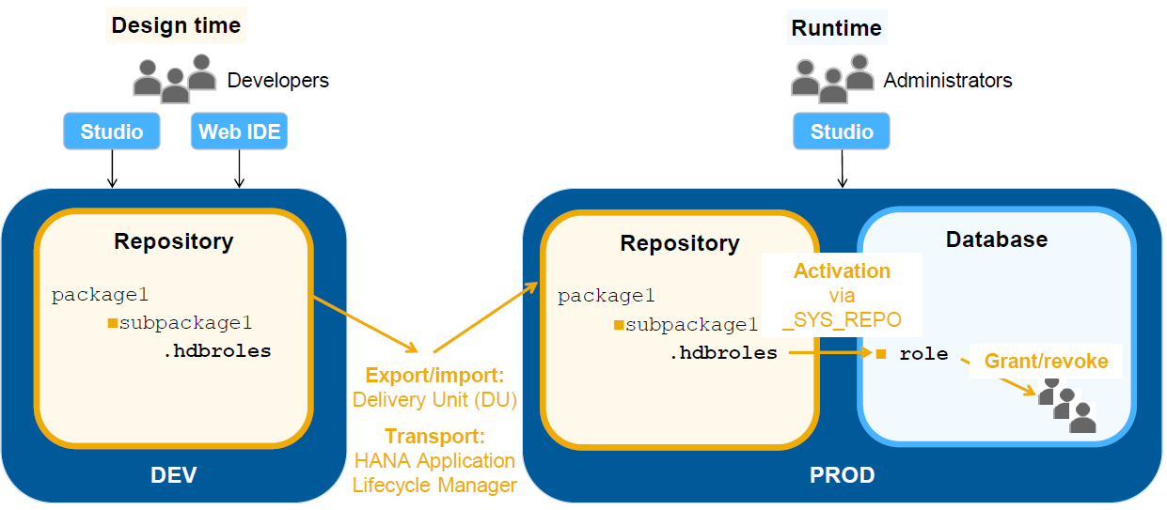
SAP HANA –role lifecycle

Slide 14
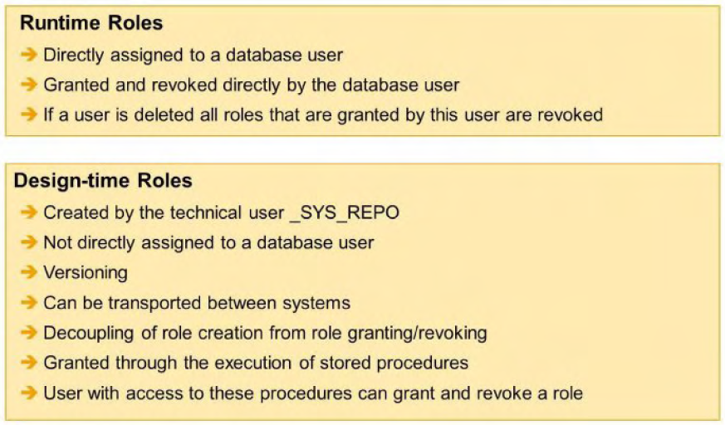
SAP HANA – Runtime & Design-time Roles

Slide 15
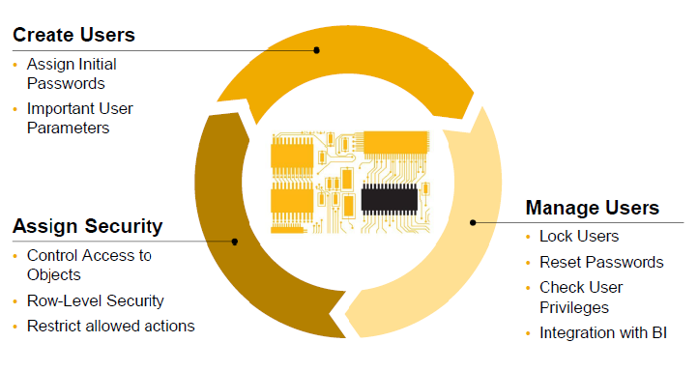
Overview of User Management in HANA
Notes:
User Provisioning and User Management
Creating Users in HANA
Actual Database Users
Create via SAP HANA Studio
Or using standard SQL statements
Authentication Methods
User / Password
Set up and manage passwords using
SAP HANA Studio or SQL
Kerberos Authentication
Certificate-based
Requires Named User in HANA DB

Slide 16

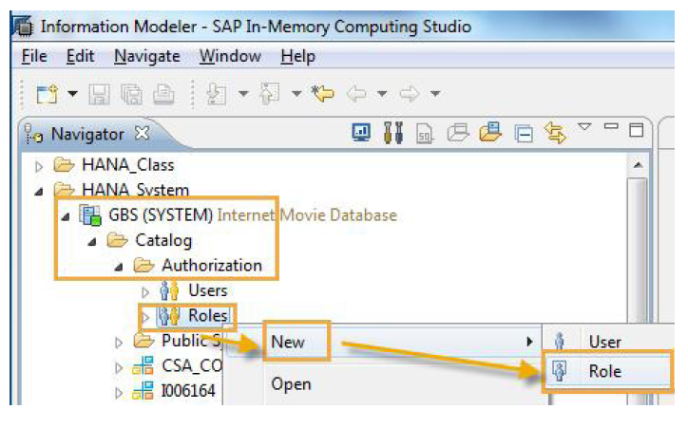
User Management in HANA …Continued
Notes:
Only the following characters are allowed in user and role names:
A-Z, 0-9, _

Slide 17
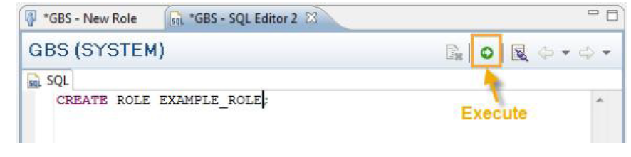
User Management in HANA …Continued
Using SQL Syntax
Run the following statement:
CREATE ROLE <ROLE_NAME>;

Slide 18

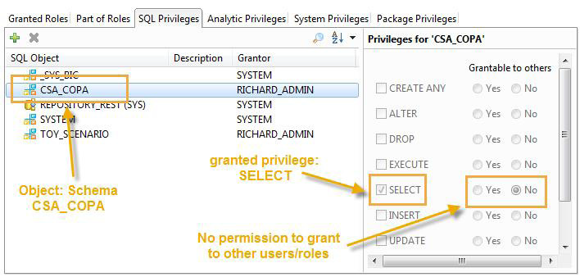
User Management in HANA …Continued
In SAP HANA Studio
Notes:
Only analytic privileges can be created, all other privileges are built in.

Slide 19
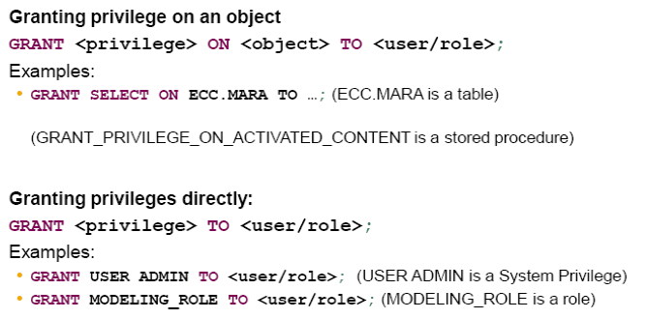
User Management in HANA …Continued
Using SQL Syntax

Slide 20

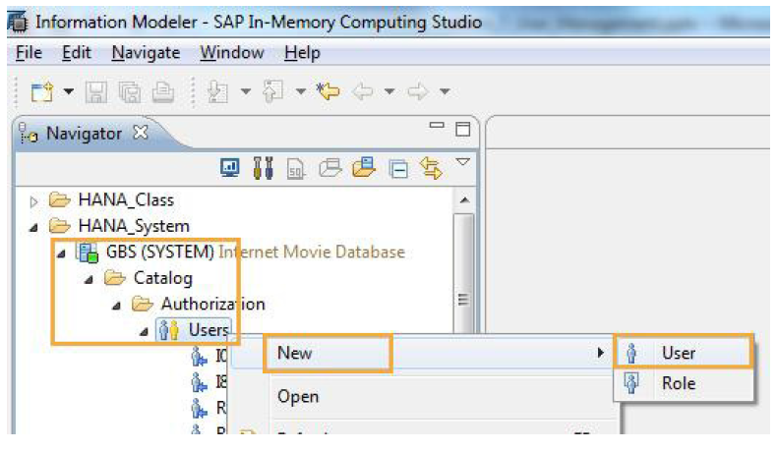
User Management in HANA …Continued
Using SAP HANA Studio

Slide 21
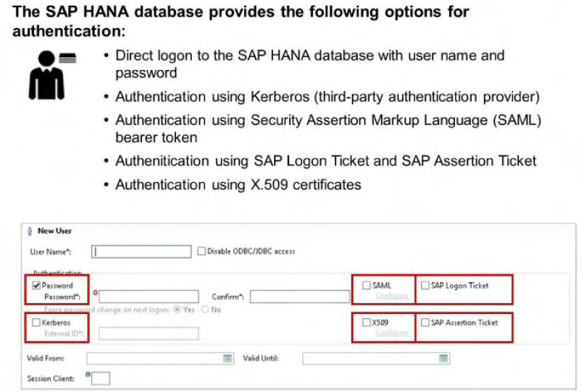
User Management in HANA …Continued
Define the initial password (user/password)
Or define the external User ID (e.g. Kerberos) - SSO

Slide 22
Integration to Single Sign on Environments
SAP HANA supports the Kerberos protocol for single sign-on. It has been tested with Windows Active
Directory Domain Kerberos implementation and MIT Kerberos network authentication protocol. The
ODBC database client and the JDBC database client support Kerberos.
To implement this, you need to install the MIT Kerberos client software on the host of the SAP HANA database. Once installation is complete, configure Kerberos as follows:
Create a user that serves as the service user for the SAP HANA database.
2. For this user, create one service principal name (SPN) for each host of the system.
The SPN needs to have the following syntax:
hdb/<domain_name>@Kerberos realm name
where <domain_name> is the fully qualified domain name of the host.
3. Export each of the SPNs created into a separate file.
4. Import the SPNs in each of the files to the respective host.

Slide 23
Integration to Single Sign on Environments …Continued
The users stored in the Microsoft Active Directory or the MIT Kerberos Key Distribution Center can be mapped to database users in the SAP HANA database. For this purpose, specify the user principal name (UPN) as the external ID when creating the database user.
To map the Kerberos-enabled provisioning mechanism to the SAP HANA database, do the following:
Launch SAP HANA studio.
In the navigator, select Catalog > Authorization.
From the context menu, select New > User.
In the "User Name" field, enter the user name.
In the "Authentication" section, choose External and enter the external ID specified in the Microsoft
Active Directory or the MIT Kerberos Key Distribution Center for the user.
Alternatively, you can create the user with the following SQL command:
CREATE USER <username> IDENTIFIED EXTERNALLY AS '<external ID>'

Slide 24
SAP HANA & SAML Authentication
Security Assertion Markup Language (SAML) is supported by HANA as an additional Authentication mechanism besides the usual username\password and Kerberos.
The main purpose of SAML for SAP HANA is to support scenarios where clients are not directly connected to SAP HANA but to a middle tier application server (like the XS Engine) that runs an HTTP server.
Supported SAML Features:
SAP HANA supports plain SAML 2.0 assertions as well as unsolicited SAML responses that include an unencrypted SAML assertion. SAML assertions and responses have to be signed using XML signatures.
The following features of XML signatures are supported:
• SHA1 and MD5 for hash algorithms
• RSA-SHA1 as signature algorithm
• <X509Certificate> elements

Slide 25
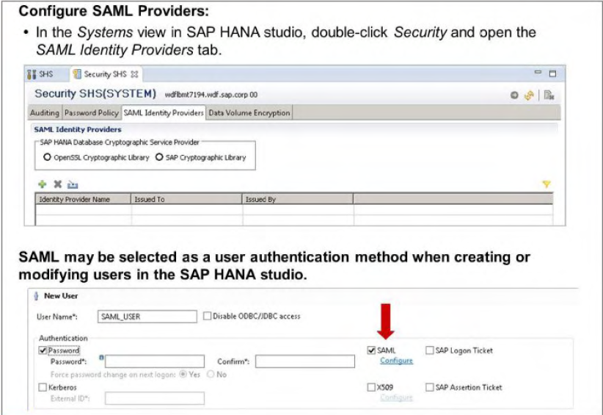
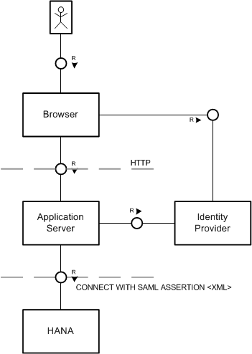
Authentication using SAML bearing token in HANA
Notes:
Whenever the application server needs to connect to the database on behalf of the user, it
requests a SAML assertion from the client. The assertion is issued by an identity provider after the
client was successfully authenticated. The assertion is then forwarded to the SAP HANA database,
which will grant access based on the previously established trust to the identity provider.

Slide 26
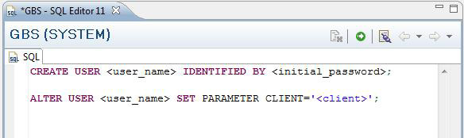
User Management in HANA …Continued
Using SQL Syntax
CREATE USER <user_name> IDENTIFIED BY <initial_password>;
CREATE USER <user_name> IDENTIFIED EXTERNALLY AS
'user@domain';
To set the Session Client parameter for the user:
ALTER USER <user_name> SET PARAMETER CLIENT='<client>';

Slide 27

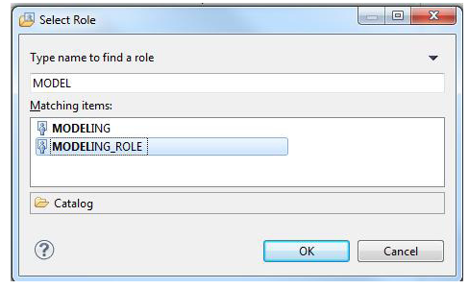
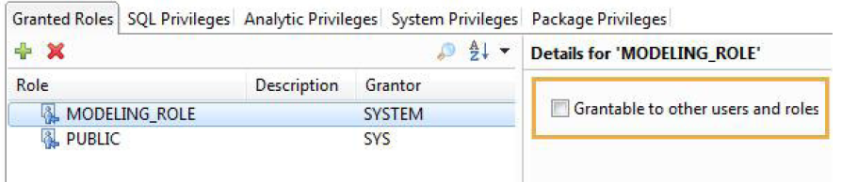
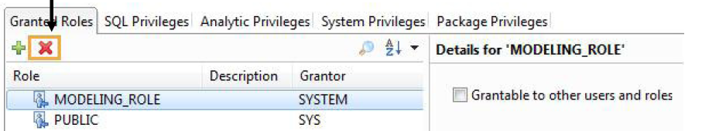
User Management in HANA …Continued
Using SAP HANA Studio
Assign Roles
Revoke Roles

Slide 28
User Management in HANA …Continued
Using SQL Syntax
Assign Roles
Enter the following SQL statement:
ı GRANT <role_name> TO <user_name>;
To also allow granting the role:
ı GRANT <role_name> TO <user_name> WITH GRANT OPTION;
Revoke Roles
Enter the following SQL statement:
ı REVOKE <role_name> FROM <user_name>;
this also revokes a GRANT OPTION (if previously given)
*** If the user had granted the role to other users, revoking the role
(and the grant option) also revokes the role from these grantees

Slide 29
User Management – Useful SQL Statements
Check history of invalid connect attempts for a given user: SELECT * FROM INVALID_CONNECT_ATTEMPTS WHERE USER_NAME
= '<name>';
Reset counter of invalid connection attempt for a given user (required to
unlock user): ALTER USER <name> RESET CONNECT ATTEMPTS;
Force a given user to change their password: ALTER USER <name> FORCE PASSWORD CHANGE;
Deactivate a given user: ALTER USER <name> DEACTIVATE USER NOW;
To re-activate a user that has been deactivated, change the user’s password
(as administrator [System privilege ‘USER ADMIN’]) ALTER USER <name> IDENTIFIED BY <new password>;
Exempt a given user from password lifetime rule:
ALTER USER <name> DISABLE PASSWORD LIFETIME;

Slide 30
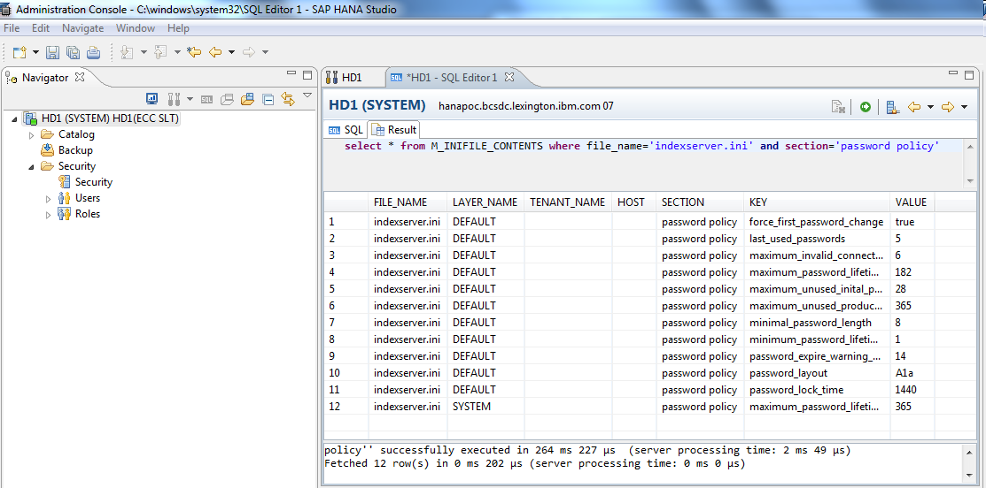
Password policies
Passwords for database users are subject to certain security rules, which are configured using parameters. These parameters can be found from the indexserver.ini file in the password policy section. M_INIFILE_CONTENTS view can be used to view the contents of the indexserver.ini file in the password policy section as follows

Slide 31
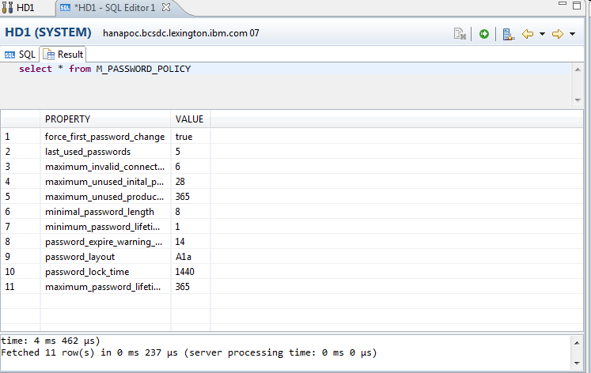
Password policies ..Continued..
Another way to view the existing password policy is to query
M_PASSWORD_POLICY view .

Slide 32
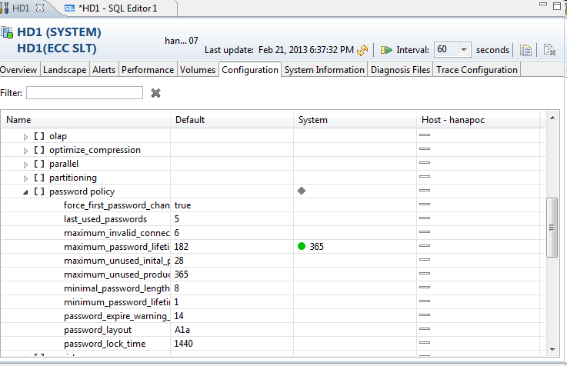
How do you change password policies in HANA
Either of the two below methodologies could be followed to change the password policy.
1.Using SAP HANA studio, follow these steps:
a. Open the Administration editor and go to the Configuration tab.
b. Expand the indexserver.ini section.
c. In the Password policy section, change the required parameters.
2. Using an SQL statement
Alter system inifile (‘indexserver.ini’ , ‘SYSTEM’)
set (‘password policy’ , ‘<parameter_name>’) = ‘<new_value>’ with reconfigure
Notes:
Examples of configurable Parameters:
ı Minimal password length (default: 8)
ı Required character groups (Upper case / Lower case / Numbers / Special
Characters) (default: Upper + Lower + Number)
ı Force changing initial passwords (default: true)
ı Number of invalid attempts before user is locked (default: 6)
ı Lock period (default: 1440 minutes = 1 day)
ı Maximum password life time (default: 182 days)

Slide 33
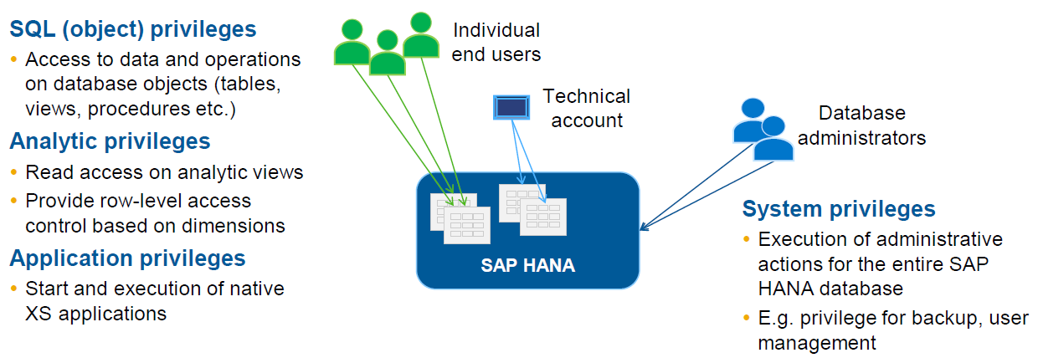
Types of Privileges in HANA

Slide 34
Analytic Privileges in HANA
Analytic Privileges are used to control access to SAP HANA data Models.
Analytic Privileges are automatically enforced for all three kinds of column views and
without Analytic Privilege, no data can be viewed from
Attribute Views
Analytic Views
Calculation Views
Implement row-level security with Analytic Privileges
Restrict access to a given data container to selected Attribute Values
Field from Attribute View
Field from Attribute View used in Analytic View
Private Dimension of Analytic View
Attribute field in Calculation View
Combinations of the above
Single value, range
Notes:
Analytic Privileges are used in the SAP HANA database to provide fine-grained control of what data
particular users can see for analytic use. They provide the ability for row-level authorization, based on
filtering the values in one or more columns. All Attribute Views, Analytic Views, and Calculation Views,
which have been designed in the information modeler and have been activated from the information
modeler of the SAP HANA studio, are automatically supported by the Analytic Privilege mechanism.
If you are already familiar with the authorization model of SAP NetWeaver Business Warehouse (SAP
NetWeaver BW), you will see many similarities between the two models.
The main idea behind AnalyticPrivileges is to allow access of different users to different portions of data of the same view.
For example,different regional sales managers, who are only allowed to see sales data for their regions, could access
the same Analytic View. They would get the Analytic Privilege to see only data for their region, and their
queries on the same view would return the corresponding data. This is a major difference to the SAP
NetWeaver BW model. While the concept itself is very similar, SAP NetWeaver BW would forward an
error message if you executed a query that would return values you are not authorized to see. With the
SAP HANA database, the query would be executed and, corresponding to your authorization, only
values you are entitled to see returned.

Slide 35
Restrictions on Analytic Privileges
An Analytic Privilege consists of several restrictions. Three of these restrictions
are always present and have the following special meanings:
One restriction (cube restriction) determines for which column views (Attribute, Analytic, or Calculation Views) the privilege is used. This may involve a single view, a list of views or, by means of a wildcard, all applicable views.
One restriction (activity restriction) determines the effected activity, for example, READ. This means that the activity READ is restricted and not available for use.
One restriction (validity restriction) determines at what times the privilege is valid.
Notes:
Privilege Name
Description
USER ADMIN
This privilege authorizes the creation and changing of users using the CREATE USER, ALTER USER, and DROP USER SQL commands.
ROLE ADMIN
This privilege authorizes the creation and deletion of roles using the CREATE ROLE and DROP ROLE SQL commands. It also authorizes the granting and revocation of roles using the GRANT and REVOKE SQL commands.
CREATE SCHEMA
This privilege authorizes the creation of database schemas using the CREATE SCHEMA SQL command
DATA ADMIN
This privilege authorizes all users to have unfiltered read-only access to the full content of all system and monitoring views as well as to execute all data definition language
CATALOG READ
This privilege authorizes all users to have unfiltered read-only access to the full content of all system and monitoring views
BACKUP ADMIN
This privilege authorizes the ALTER SYSTEM BACKUP command to define and initiate a backup process or to perform a recovery process.
SAVEPOINT ADMIN
This privilege authorizes the execution of a checkpoint process.
INIFILE ADMIN
This privilege authorizes different methods to change system settings.
LOG ADMIN
This privilege authorizes the ALTER SYSTEM LOGGING [ON|OFF] commands to enable or disable the log flush mechanism.

Slide 36
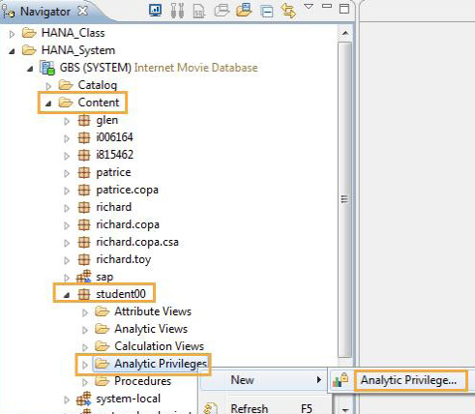
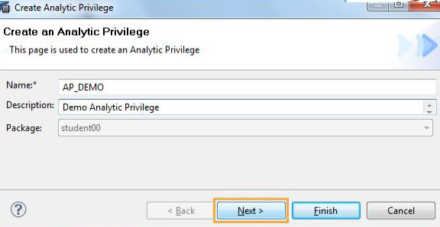
Creating Analytic Privileges
Right Click applicable package & click New -> Analytic Privilege.
Enter appropriate Name & Description of the privilege and then click Next
Notes:
The information modeler provides a convenient way of defining and enforcing Analytic Privileges on column views.
To define an analytic privilege, the user should select all relevant views (reference models) to which this Analytic privilege is applicable. Instead of choosing single relevant views, you can also choose “Applicable to Information Models “ checkbox to indicate that it is applicable to all possible views.
Some restrictions set by the information modeler are as follows:
For Cube restriction: In general an Analytic Privilege is valid only for those views specified in the cube restriction.
All analytic privileges are set to READ activity only, ‘cause the target views are readonly.
Validity: After activation , they have immediate validity and an unlimited validity period.
Dimension restriction: For dimension restriction various operators like “>”, “>”, “=“,”<>”, etc can be used.
36

Slide 37
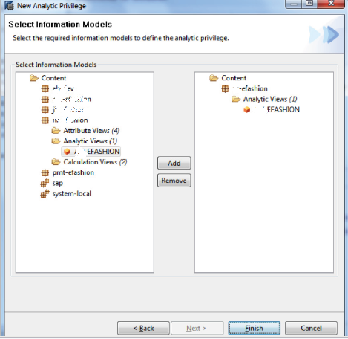
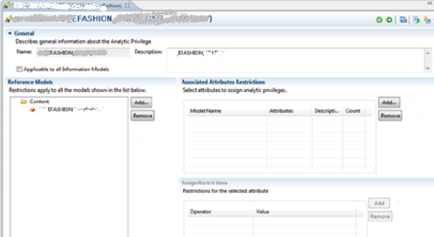
Creating Analytic Privileges Continued…
Select required Information Model to define Analytic Privilege for that model
2
1
3

Slide 38
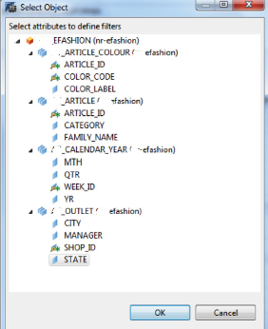
Creating Analytic Privileges Continued…
Under Associated Attributes Restrictions click Add to add attribute which wll be used for filter-
2
3
Under Assign Restrictions click the Add button to
Add values for that filter which data can be seen.
In the final stage need to activate this privilege.

Slide 39
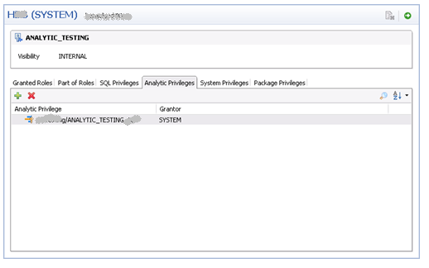
Package Privileges in HANA
Package Privileges control:
Reading the list of views inside of a package
Creation of views inside of a package
Modification of views inside of a package
Reading view definitions inside of a package
Activation of views inside of a package
Creation of sub-packages inside of a package
Can assign/remove Privileges to users
Notes:
In the SAP HANA studio, you can manage the package privileges on the Package Privileges tab. The SAP HANA database repository is structured hierarchically with packages assigned to other packages as sub-packages. If you grant privileges to a user for a package, the user is automatically also authorized for all corresponding subpackages.
In the SAP HANA database repository a distinction is made between native and imported packages.
Native packages are packages that were created in the current system and should therefore, be edited in the current system. Imported packages from another system should not be edited, except by newly imported updates.
An imported package should only be manually edited in exceptional cases.
Privileges for native packages are as follows:
Privilege Name Description
REPO.READ - This privilege authorizes read access to packages and design-time objects, including both native and imported objects.
REPO.EDIT_NATIVE_OBJECTS - This privilege authorizes all kinds of inactive changes to design-time objects in native packages.
REPO.ACTIVATE_NATIVE_OBJECTS - This privilege authorizes the user to activate or reactivate design-time objects in native packages.
REPO.MAINTAIN_NATIVE_PACKAGES -This privilege authorizes the user to update or delete native packages, or create sub-packages of native packages.
Developers should only be granted the following privileges for imported packages in exceptional cases:
Package Privilege Name Description
REPO.EDIT_IMPORTED_OBJECTS - This privilege authorizes all kinds of inactive changes to design-time objects in imported packages.
REPO.ACTIVATE_IMPORTED_OBJECTS - This privilege authorizes the user to activate or reactivate design-time objects in imported packages.
REPO.MAINTAIN_IMPORTED_PACKAGES - This privilege authorizes the user to update or delete imported packages, or create subpackages of imported packages.
39

Slide 40
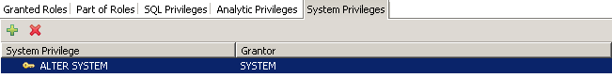
System Privileges in HANA
Fixed set of privileges
Restrict execution of administration tasks within the database, such as user management
System Privileges
USER ADMIN, ROLE ADMIN, DATA ADMIN, ALTER SYSTEM, ALTER DATABASE, CREATE SCHEMA
System privileges are assigned/revoked using the administration console of the SAP In- Memory Computing Studio
Can assign/remove System Privileges to users
Notes:
These are system wide SQL privileges controlling general system activities mainly for administrative purposes such as creating schemas, creating and changing users and roles.
The System Privileges are assigned to users and roles. Following the principle of least privilege, users should only be given the smallest set of privileges required for their role.

Slide 41
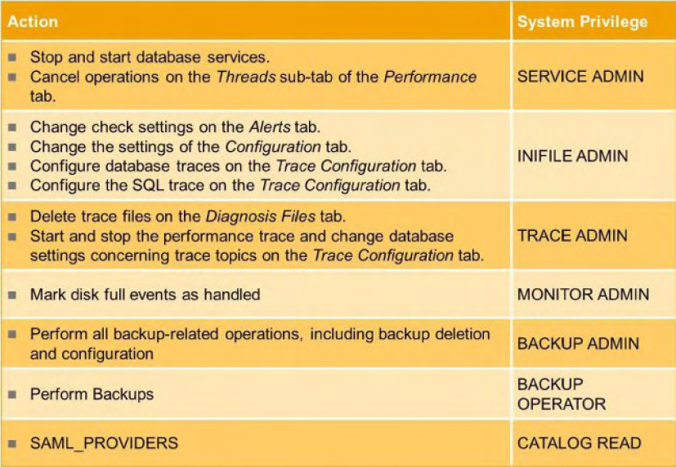
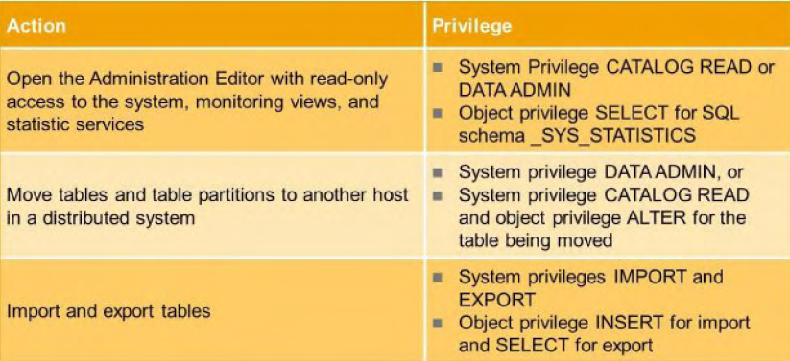
Privileges for admin tasks

Slide 42
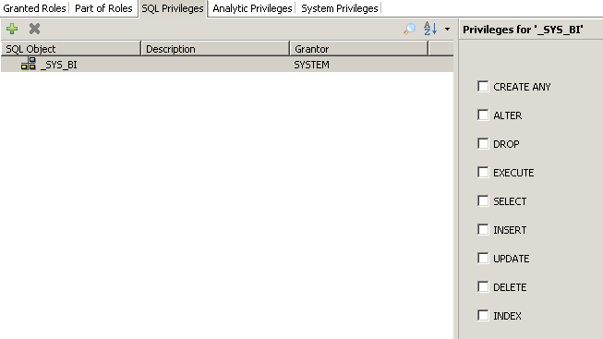
SQL Privileges in HANA
SQL privileges :
Fixed set of privileges
Restrict access to and modification
of database objects such as tables
Schema privileges:
DROP, CREATE [ANY], INSERT, SELECT, UPDATE, DELETE, EXECUTE
Data Object privileges:
INSERT, SELECT, UPDATE, DELETE, EXECUTE, INDEX, ALTER, DROP
SQL privileges are assigned/revoked
using the Administration Console
Perspective of the SAP In-Memory
Computing Studio
Notes:
These privileges are used to restrict access to and modification of database objects such as tables. Depending on the object type (tabl\view) actions (e.g. CREATE ANY, ALTER, DROP) can be authorized per object.

Slide 43
Some Common Scenarios
What privileges do I need in order to read from a given view?
One always needs SQL SELECT for the column view
For Attribute Views:
No Analytic privilege required / possible (can create them, but they are not
evaluated)
Need SQL SELECT on the Column View for the Attribute View
For Analytic Views:
At least one analytic privilege is needed -> Defined on Analytic View itself, or on
Attribute View used within Analytic View
Without analytic privilege for the view, no data is returned
There is a „See everything system wide“ privilege: „_SYS_BI_CP_ALL“
Need SQL SELECT for the Column View for the Analytic View
For Calculation views:
No analytic privilege required for the Calculation View itself
If Analytic View used in Calculation View: need Analytic Privilege for that Analytic
View
Need SQL SELECT for all views and tables explicitly used in the Calculation View
Need SQL SELECT for the Column View for the Calculation View

Slide 44
Some Common Scenarios
What privileges do I need in order to do modeling?
SQL Privileges needed:
CREATE ANY, INSERT, UPDATE, DELETE, SELECT on _SYS_BIC – the
modeler creates column views in that schema
SELECT on the tables used in the view - in the test system system: you may
have SELECT for the entire SYSTEM schema.
System privileges:
ALTER SYSTEM, DATA ADMIN
Analytic Privileges:
Strictly, none required
For being able to preview/test views: some analytic privilege
In the test system : you have may have „_SYS_BI_CP_ALL“
Consequences of these facts:
Any Modeler can create their own analytic privileges, since they have „
ALTER SYSTEM“
Any Modeler can see all data in the tables they use in the model
Any Modeler can see all data in the views (because they can authorize
themselves)
Modeling on confidential data hardly possible in a production system
Need two-system landscape, model on randomized data, then import

Slide 45
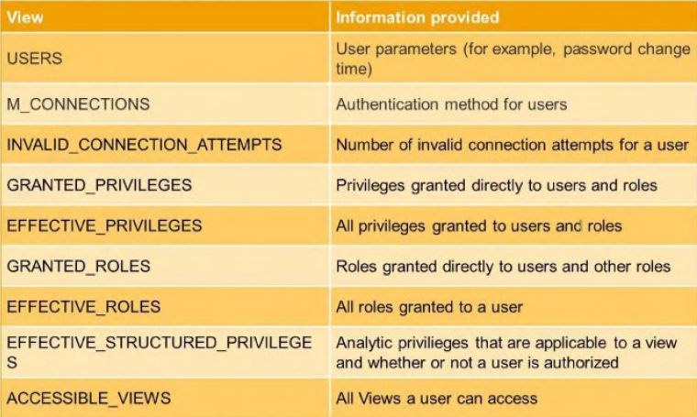
Information Sources for Administrators

Slide 46
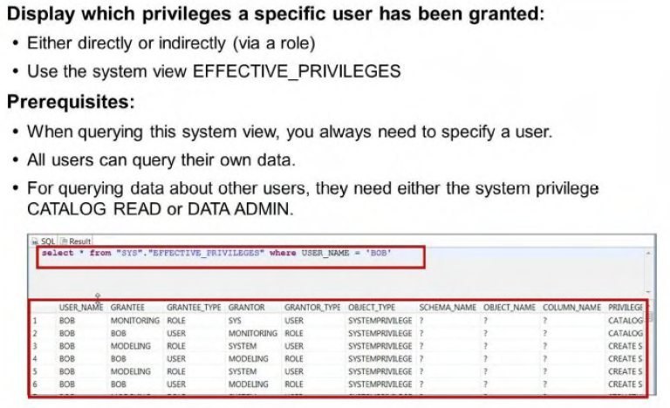

Slide 47
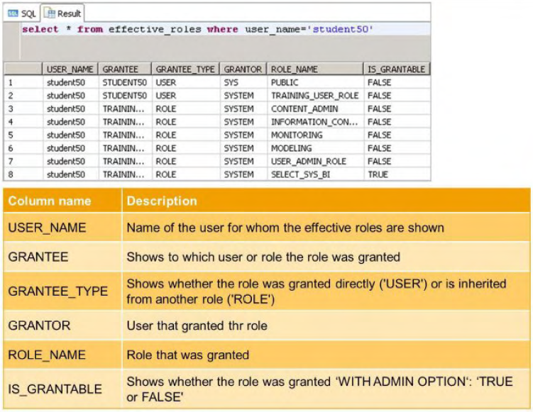

Slide 48
Encryption
In order to protect against security breaches or outside attacks, companies prefer to protect the data using encryption. The encryption can done on data transfers but also on the data stored on a system.
Secure Communication – Encryption of data communication in the network
• Network traffic can be encrypted using Transport Layer Security (TLS ), both between the SAP HANA database and clients, as well as between hosts in a distributed SAP HANA system.
Encryption of the data persistence layer
• The SAP HANA database can encrypt data at rest (data volumes)
• Encryption works at the page level and uses the AES256 encryption algorithm
For the configuration of secure communication using TLS and the encryption of the persistence layer a cryptographic service provider is available on the server. SAP HANA supports the following cryptographic libraries:
• CommonCryptolib (default)
CommonCryptoLib (libsapcrypto.so) is installed by default as part of SAP HANA server installation at $DIR_EXECUTABLE.
• OpenSSL
The OpenSSL library is installed by default as part of the operating system installation.

Slide 49
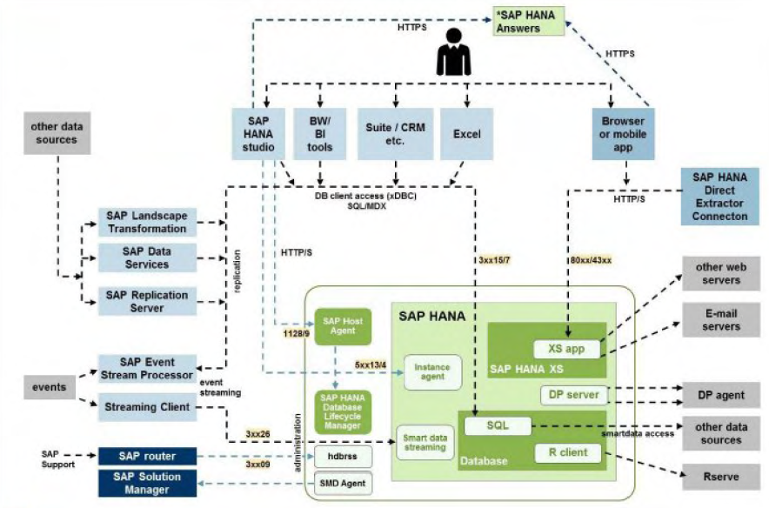
SAP HANA –secure communication
Types of Network Communication Channels
• Channels used for external access to SAP HANA functionality by end-user clients,
administration clients. application servers. and for data provisioning through SQL or HTTP
• Channels used for SAP HANA internal communication within the database. between hosts in multiple-host systems. and between systems in system-replication scenarios
• Connections used for administrative purposes
• Connections used for data provisioning
• Connections from database clients that access the SQL interface of the SAP HANA database
• Connections from HTTP(S) clients
• Outgoing connections

Slide 50
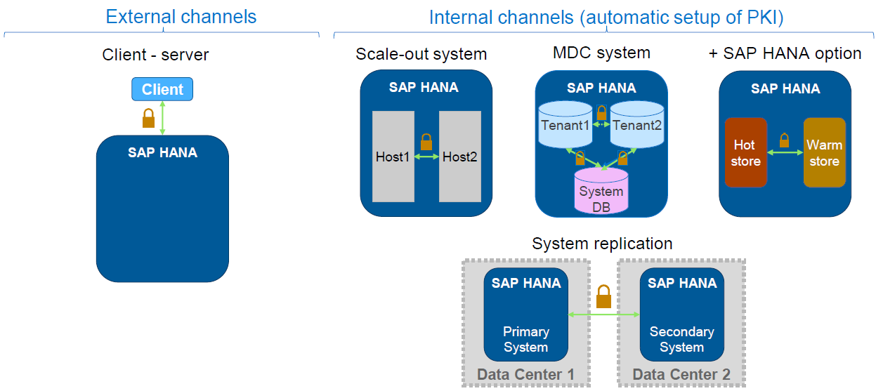
SAP HANA –secure communication
A public-key infrastructure (system PKI) for securing internal communication channels using TLS is set up automatically during installation.
No user interaction is required for the setup.

Slide 51
SAP HANA Network Security
The SAP HANA appliance should be operated in a protected data center environment. Only dedicated authorized network traffic should be allowed from other network zones (for example, user access from client network zone).
Client access (that is, all access to external standard database functionality, for example SQL) only requires access to the client access port.
In distributed scenarios, clients must be able to access every node of the distributed SAP HANA appliance.
For some administrative functions (for example, starting and stopping the SAP HANA instance) access to the administrative ports is additionally required.
Database internal communication is only used for communication within the database or, in a distributed scenario, for the communication between hosts.
In a single blade scenario (one instance of SAP HANA on one blade), access to those ports from other hosts in the network must be blocked
The internal communication must be strictly separated from the external or client communication paths. Access from hosts which are not part of an instance of the SAP HANA appliance should be blocked.
Notes:
51

Slide 52
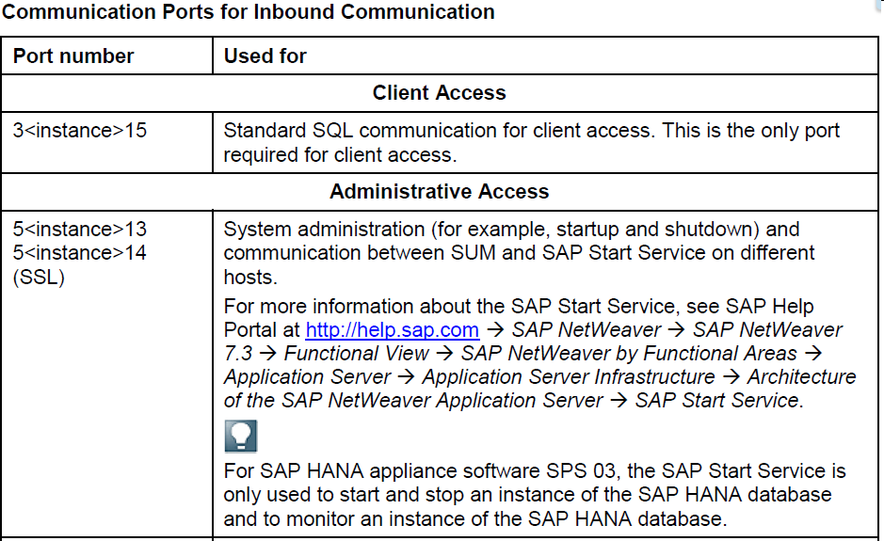
SAP HANA Communication Ports
Communication ports: The table below lists the ports that are used by SAP HANA. The notation of the ports is as follows: 3 <instance> xy, where <instance> is a double digit number representing the instance number of the SAP HANA appliance. xy represents a consecutive number.
Notes:
52

Slide 53
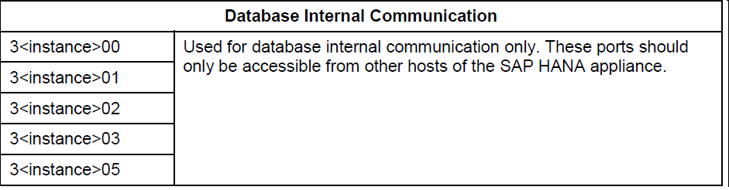
SAP HANA Communication Ports & Secure Communication
Secure communication
The SAP HANA appliance uses the Secure Sockets Layer (SSL) protocol to provide secure communication between the individual components and client connections. Authentication is ensured by using certificates.
The communication between the following components can be secured by using SSL:
● Any ODBC- or JDBC-based connection
● SAP HANA studio – SAP HANA database (server authentication)
● SAP HANA studio – Software Update Manager for SAP HANA
● Software Update Manager for SAP HANA – SAP Service Marketplace. SAP HANA needs an SAP Service
Marketplace user (S-user) to access the SAP Service Marketplace. These credentials are sent only via
encrypted communication channels using an HTTPS connection.
● Software Update Manager for SAP HANA – SAP Host Agent
● SAP HANA Information Composer – Browser
Notes:
53

Slide 54
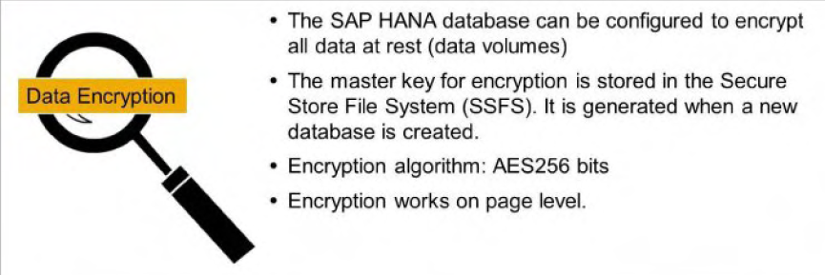
Data Volume Encryption
Data volume encryption ensures that anyone who can access the data volumes on disk using operating system commands cannot see the actual data. If data volumes are encrypted, all pages that reside in the data area on disk are encrypted using the AES-256-CBC algorithm.
Pages are transparently decrypted as part of the load process into memory.
When pages reside in memory, they are, therefore, not encrypted and there is no performance overhead for in-memory page accesses. When changes to data are persisted to disk. the relevant pages are encrypted automatically as part of the write operation.
Persistence Encryption has the following restrictions.
It does not encrypt Database redo logs.
It does not encrypt Backups.
It does not encrypt Database traces.
Secure User Store:
In secure user store of the SAP Hana client hdbuserstore, you can securely store the user logon information, including passwords using SSFS functionality. This allows the client programs to connect to the database without having to manually enter the password. The secure store is installed with the SAP HANA client package. After installation it is located in /usr/sap/hdbclient directory.
54

Slide 55
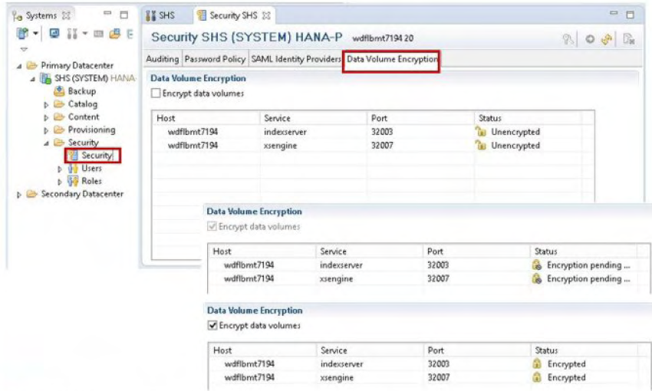
Configure Data Volume Encryption
Data volume encryption on disk can be configured using SAP HANA studio or SQL commands.
After activating encryption. new data that is saved to disk will be encrypted starting with the next savepoint.
To achieve complete protection it is necessary to enable data volume encryption after re-installing the system.
Only after this process has completed is all your data
encrypted. This also ensures that a new root encryption
key is generated.

Slide 56
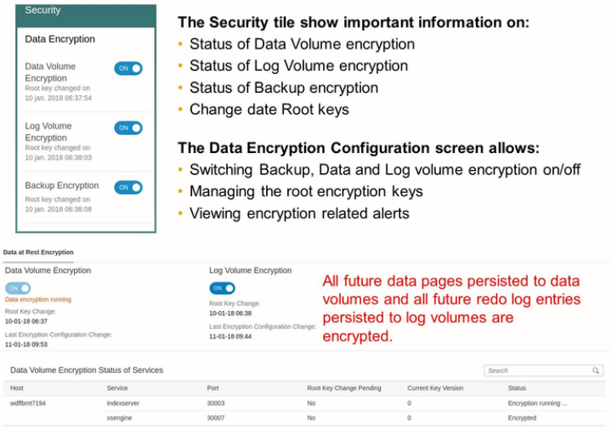
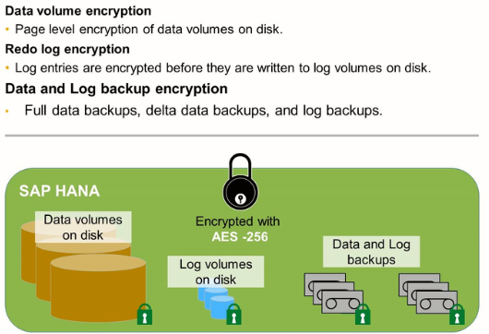
Data Volume Encryption

Slide 57
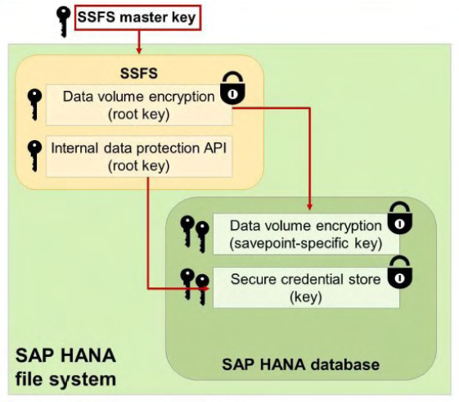
SSFS Encryption Keys
SAP HANA uses the secure storage in the file system (SSFS) to securely store the root encryption keys used to protect all encryption keys used in an SAP HANA system. The encrypted storage of the data prevents unauthorized persons or programs being able to access this data.
These are the root encryption keys for the following:
• Data volume encryption • Internal data protection API (DPAPI). (For smart data access to store additional user credentials)
The page encryption keys used for data volume encryption are encrypted themselves with the data volume encryption root key. The root key is generated randomly during installation. The page keys are created when data volume encryption is enabled
This secure store. which is used by SAP HANA to store internal root keys is protected by the so called SSFS master key. In order to support automatic unattended start-up of HANA system, the key store and the SSFS master key is stored on the file system, protected by operating system permissions of sidadm.
An administrator can change the SSFS master key using the command line tool rsecssfx using the credentials of the operating system user <sid> adm. Therefore the SAP HANA system has to be stopped.

Slide 58
Change the SSFS Master Keys
To change the SSFA master keys, proceed as follows:
1.Log on to the SAP HANA system host as the operating system user <sid>adm.
2.Shut the system down using the sapcontrol program: /usr/sap/hostctrl/exe/sapcontrol -nr <instance_no> -function Stop
3.Change the master key of the instance SSFS as follows:
a.Re-encrypt the instance SSFS with a new key with the command:
RSEC_SSFS_DATAPATH=/usr/sap/<SID>/SYS/global/hdb/security/ssfs RSEC_SSFS_KEYPATH=<path to key file> rsecssfx changekey $(rsecssfx generatekey -getPlainValueToConsole)
b.Configure the specified key file location in the global.ini configuration file
at /usr/sap/<SID>/SYS/global/hdb/custom/config/global.ini.
If the file does not exist, create it. Add the following lines:
[cryptography] ssfs_key_file_path = < path to key file>
4.Re-encrypt the system PKI SSFS with a new key using the following command:
RSEC_SSFS_DATAPATH=/usr/sap/<SID>/SYS/global/security/rsecssfs/data RSEC_SSFS_KEYPATH=/usr/sap/<SID>/SYS/global/security/rsecssfs/key rsecssfx changekey $(rsecssfx generatekey –getPlainValueToConsole
5.Restart the system using the following command: /usr/sap/hostctrl/exe/sapcontrol -nr <instance_no> -function Start

Slide 59
Database Storage Security
The user store can be opened by executing hdbuserstore script using a user key
Following command creates User key in the user store and stores the password under this user key
hdbuserstore SET <user_key> <env> <user_name> <password>
eg: hdbuserstore SET moorf localhost:30115 FrankMoore 1qaz@WSX
List all available user keys can be found using the following command
hdbuserstore list moorf
Output (with above example):
Key:moorf
ENV: localhost:30115
User: FrankMoore
Call hdbsql with the user key
hdbsql -U moorf

Slide 60
SAP HANA – Audit perspective
The main requirement for auditing a system is traceability of actions performed in that system.
Following are the main objectives of auditing
Uncover security holes
Show security breaches and privilege misuses
Protect the system owner against accusations of security violation and data misuse
The system owner meet their security standards.
Audit Policies
Audit policies define which events to audit. Each policy has a name and can be enabled or disabled by the administrator. Audit policies are owned by the system; they are not dropped when the creating user is removed.
Policy Actions
Actions are organized in different groups, some of them needing a target object, while others do not need any target object. Actions belonging to both of those two categories must never be combined in the same audit policy. Some actions can combine different database actions to one single entity, meaning that a policy having only one single audit action can fire on very different SQL statements. The action list can contain an arbitrary number of audit actions, but must have at least one action.
Note: Auditing can be activated or disabled per tenant. In SystemDB, audit trial targets can be configured but in a tenant it cannot be changed

Slide 61


Audit Logging

Slide 62

SAP HANA – Audit perspective …Continued
Some Auditing Actions :

Slide 63

SAP HANA – Audit perspective …Continued
Some Auditing Actions :

Slide 64
SAP HANA – Audit perspective …Continued
Action Status :
The action status must be set to:
SUCCESSFUL
UNSUCCESSFUL
ALL
Unsuccessful in this case means that the user was not authorized to execute the action. If another error occurs (for example, misspellings in user or object names and syntax errors), the statement is not audited.
Audit Level :
An audit level is assigned to each policy. Possible levels, in decreasing order of importance, include:
EMERGENCY
ALERT
CRITICAL
WARNING
INFO

Slide 65

SAP HANA – Audit perspective …Continued
The following are the Audit controlling privileges.
CREATE AUDIT POLICY
DROP AUDIT POLICY
ALTER AUDIT POLICY
Audit Entries
The table below shows some of the fields of audit entries and their meaning.

Slide 66


Enable Audit Policy in SAP HANA Studio

Slide 67


Enable Audit Policy in SAP HANA Cockpit

Slide 68


Monitor Audit Log Policies and Check Status

Slide 69
SAP HANA – Audit perspective …Continued
Global Audit Configuration
To maintain the global audit configuration, users need the INIFILE ADMIN System Privilege. Then, they can use the following statements to alter the configuration of the auditing system.
Activate or Deactivate Global Auditing
Activate global auditing:
alter system inifile ('global.ini','SYSTEM') set ('auditing configuration','global_auditing_state' ) = 'true' with reconfigure;
Deactivate global auditing:
alter system inifile ('global.ini','SYSTEM') set ('auditing configuration','global_auditing_state' ) = 'false' with reconfigure;
Set Audit Trail Type
Set the audit trail type CSVTEXTFILE:
This is for testing purposes only; do not use in productive environments.
alter system inifile ('global.ini','SYSTEM') set ('auditing configuration','default_audit_trail_type' ) = 'CSVTEXTFILE' with reconfigure;
Set the audit trail type SYSLOGPROTOCOL:
alter system inifile ('global.ini','SYSTEM') set ('auditing configuration','default_audit_trail_type' ) = ‘SLOGPROTOCOL‘ with reconfigure;
Set Audit Target Path
Setting the audit target path only works when the audit trail type is CSVTEXTFILE:
This is for testing purposes only; do not use in productive environments.
alter system inifile ('global.ini','SYSTEM') set ('auditing configuration','default_audit_trail_path' ) = '<path>‘ with reconfigure;

Slide 70
SAP HANA – Audit perspective …Continued
Manage Audit Policies
To manage audit policies, the AUDIT ADMIN System Privilege is required.
Create Audit Policy :
CREATE AUDIT POLICY <policy_name> AUDITING <ACTIONSTATUS> <ACTIONLIST> LEVEL <AUDITLEVEL>;
By default, all audit policies are created in inactive state.
Enable the audit policy:
ALTER AUDIT POLICY <policy_name> ENABLE;
Disable the audit policy:
ALTER AUDIT POLICY <policy_name> DISABLE;
Drop Audit Policy :
DROP AUDIT POLICY <policy_name>;
Show Audit Policies :
SELECT * FROM "PUBLIC"."AUDIT_POLICIES“
Example: Audit logging for creating or dropping of roles and users, write audit messages with level "critical":
1. Create audit policy:
CREATE AUDIT POLICY policyAdministratePrincipals AUDITING ALL CREATE ROLE,
DROP ROLE, CREATE USER, DROP USER LEVEL Critical;
2. Activate audit policy:
ALTER AUDIT POLICY policyAdministratePrincipals ENABLE;

Slide 71

Monitor the Size of the Audit Trail Table
If the audit trail is written to an internal SAP HANA table, you need to manage the size of this table.
In order to support administrators to monitor database growth. an alert has been implemented for the size of the audit trail table.
SAP HANA monitors the size of the audit table with respect to the overall memory allocation limit of the system and issues an alert when it reaches the following (default) values: 5%, 70/o. and 9% of the allocation limit.
You can delete old audit entries from the audit table using SAP HANA Studio.
If however the table has grown so large that there is not enough memory for deleting old entries. you can now use the following SQL command to completely
empty the table
ALTER SYSTEM CLEAR AUDIT LOG ALL

Slide 72
Some Relevant SAP notes
SAP Note | Title
1598623 | SAP HANA appliance :Security
1514967 | SAP HANA appliance :Central Note
1730928 | Using external software in an SAP HANA appliance
1730929 | Using external tools in an SAP HANA appliance
1730930 | Using antivirus software in an SAP HANA appliance
1730932 | Using backup tools with Backint for SAP HANA
1730996 | Nonrecommended external software and software versions
1730997 | Nonrecommended versions of antivirus software
1730998 | Nonrecommended versions of backup tools
1730999 | Configuration chnages in SAP HANA appliance
1731000 | Non-recommended configuration changes.
72

Slide 73


Slide 74


